Slide 1
LEX

Slide 2
Structure of a LEX file
The LEX file consists of three sections, separated by a line with just %% in it:
definitions section
%%
rules section
%%
user code section

Slide 3
Definitions Section
The definitions section contains declarations of simple name definitions to simplify the scanner specification.
Name definitions have the form:
name definition
Example:
DIGIT [0-9]
ID [a-z][a-z0-9]*
The definition section is the place to define macros and to import header files written in C. It is also possible to write any C code here

Slide 4
Rules Section
The rules section of the lex input contains a series of rules of the form:
pattern action
Example:
{ID} print the number of ids

Slide 5
User Code section
The C code section contains statements and functions
These statements presumably contain code called by the rules in the rules section

Slide 6
Designing Patterns
Designing the proper patterns in lex can be very tricky, but you are provided with a broad range of options for your regular expressions.
. A dot will match any single character except a newline.
*,+ Star and plus used to match zero/one or more of the preceding expressions.
? Matches zero or one copy of the preceding expression

Slide 7
Designing Patterns
| A logical ‘or’ statement - matches either the pattern before it, or the pattern after.
^ Matches the very beginning of a line.
$ Matches the end of a line.
/ Matches the preceding regular expression, but only if followed by the subsequent expression

Slide 8
Designing Patterns
[ ] Brackets are used to denote a character class, which matches any single character within the brackets. If the first character is a ‘^’, this negates the brackets causing them to match any character except those listed. The ‘-’ can be used in a set of brackets to denote a range.
“ ” Match everything within the quotes literally
( ) Group everything in the parentheses as a single unit for the rest of the expression.

Slide 9
Example Patterns
[0-9]
A single digit.
[0-9]+
An integer.
[0-9]+(\.[0-9]+)?
An integer or floating point number.
[+-]?[0-9]+(\.[0-9]+)?([eE][+-]?[0-9]+)?
Integer, floating point, or scientific notation.

Slide 10
LEX process
Create a specification in a file called scan.l
lex processes scan.l and produces lex.yy.c
The c compiler can turn lex.yy.c into a.out
$ lex scan.l
$ cc lex.yy.c -ll
  (-ll means link with lex library,)
$ ./a.out

Slide 11
Simple program
%{
#include <stdio.h>
int c, n;
%}
%%
. {c++;}
\n {n++;}
%%
main()
{
printf(“enter”);
yylex();
printf(“The number of characters is \n”,c);
printf(“The number of lines is \n”,n);
}

Slide 12
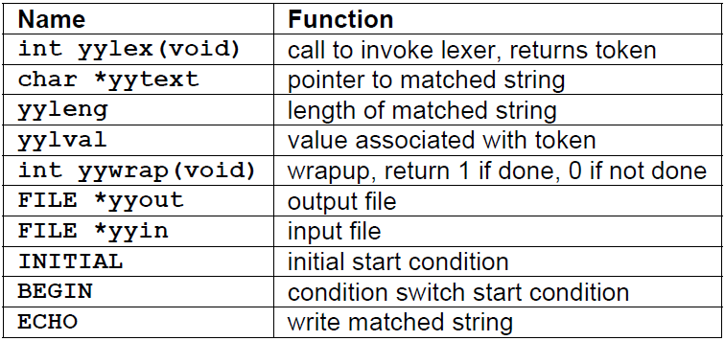
Special Functions

Slide 13
Program to recognize whether a given sentence is simple or compound.
%{
#include<stdio.h>
int i=0;
%}
alpha [a-zA-Z]
%%
and|or|but|neither|nor|whether {i=1;}
. ;

Slide 14
%%
main()
{
printf("\n Enter a sentence: ");
yylex();
if(i)
printf("compound sentence");
else
printf("simple sentence");
}

Slide 15
Write a LEX program to eliminate comment lines in a C program and copy the resulting program into a separate file.

Slide 16
Write a LEX program to recognize valid arithmetic expression. Identifiers in the expression could be only integers and operators could be + and *. Count the identifiers & operators present and print them separately.

Slide 17
Program to count the number of characters, words, spaces and lines in a given input file.
%{
int w=0,c=0,l=0,b=0;
%}
word [^ \t\n]+
eol \n
%%
[ ] b++;
{word} {w++;c+=yyleng;}
{eol} {l++;}
%%

Slide 18
int main(int argc,char *argv[])
{
FILE *fp;
if(argc>1)
{
fp=fopen(argv[1],"r");
if(!fp)
{
printf("Cannot Open FILE\n");
exit(0);
}

Slide 19
yyin=fp;
yylex();
printf("\nWord=%d\nChar=%d\nLin=%d\nBlank=%d\n",w,c,l,b);
}
else
printf("Too FEW Arguments\n");
return 0;
}

